Slide 1
EDA Presentation: Diversified Company Metrics
Exploration of distributions, frequencies, and relationships across a mixed corporate dataset

Slide 2
Introduction
Problem statement: Understand diversity and drivers of business performance across a mixed dataset of
firms to inform growth, risk management, and go-to-market strategies.
Data and scope: Core numeric metrics (employee_count, annual_revenue_million, profit_margin_percent,
founded_year, customer_count, market_rating) plus categorical fields (industry, country, region). Visual
exploration focused on distributions, category frequencies, and relationships.
Objective: Identify how firm size, revenue, profitability, and market position vary by industry/region, and
uncover actionable patterns for segmentation and targeted interventions.

Slide 3
Methods
Overview of approach:
Descriptive statistics to summarise central tendency and dispersion
Univariate visualisations: histograms and bar charts to show distributions
Multivariate visualisations: boxplots and a correlation heatmap to assess relationships
Scatter analysis: industry-by-employee-count vs revenue to inspect size–revenue dynamics
Synthesised narrative: integrated insights across chart families
Libraries and tools (Python ecosystem):
pandas for data handling and aggregation
numpy for numerical operations
matplotlib and seaborn for visualisations (histograms, boxplots, heatmaps, scatter plots)
scipy.stats for basic statistical measures (z-scores, skewness, kurtosis)

Slide 4
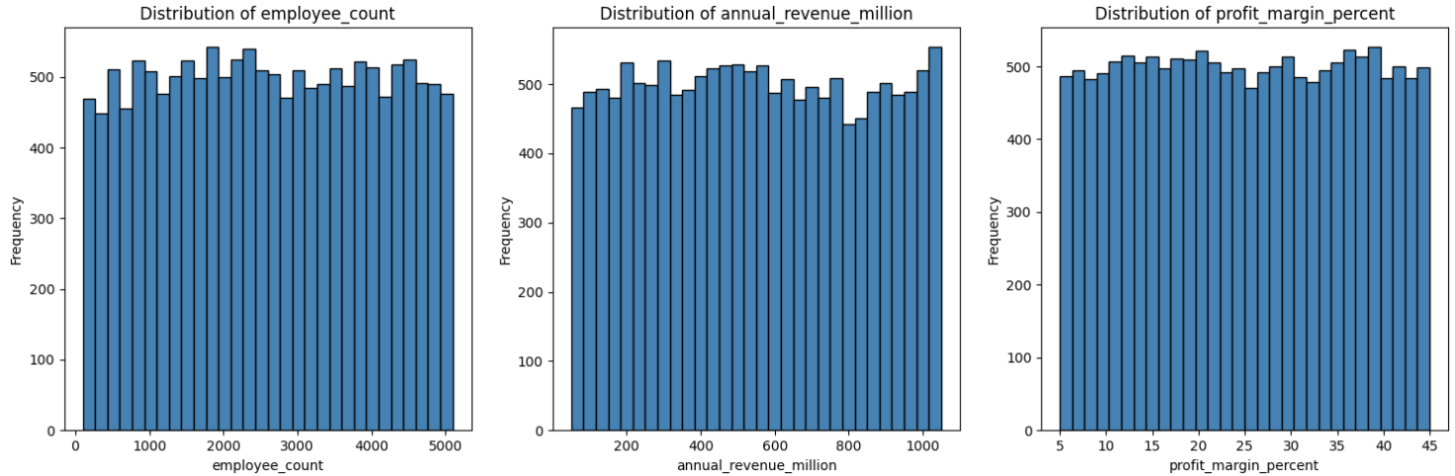
Distribution Snapshot: Core Numerical Metrics
Insights:
Centred around mid-range for size and revenue
Moderate variability in profit margins
Early 2000s founding cluster
Wide spread in customer base and region ratings

Slide 5
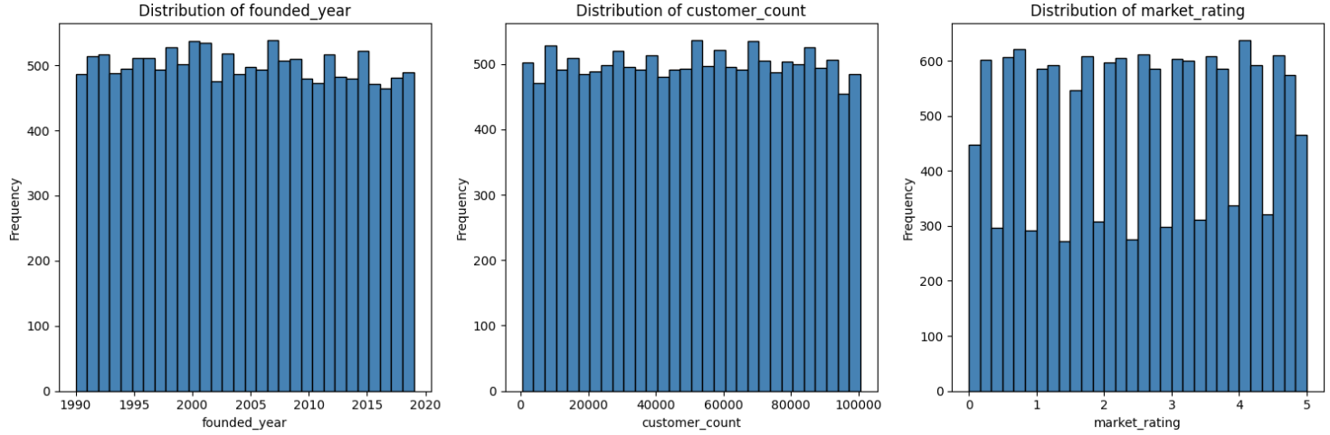
Distribution Snapshot: Core Numerical Metrics [continued]
Insights:
Clustering around the early 2000s
High heterogeneity in customers
Market ratings broadly mid-to-high, with room for top-tier improvement.

Slide 6
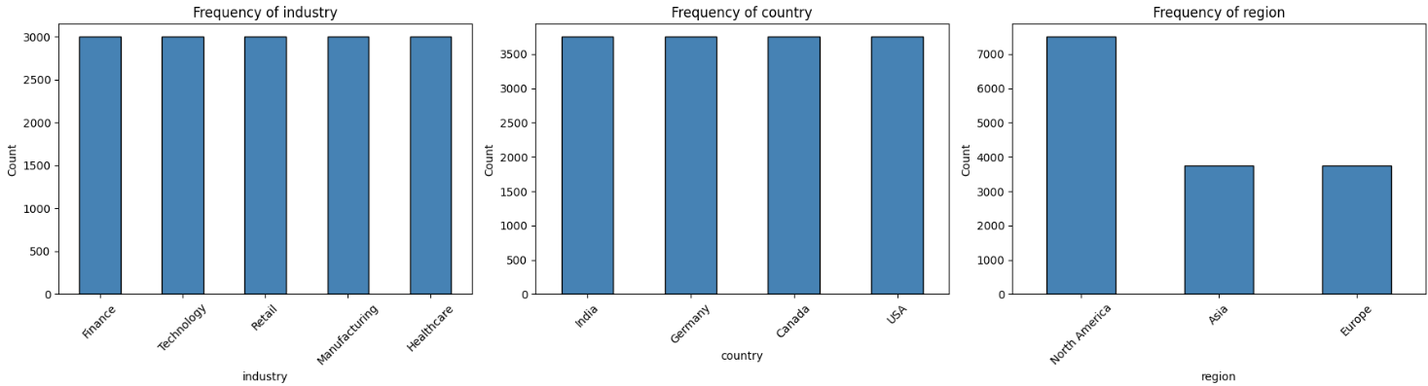
Categorical Frequencies
Insights:
Balanced industry distribution
Diverse geographic footprint
North America shows higher representation by region.

Slide 7
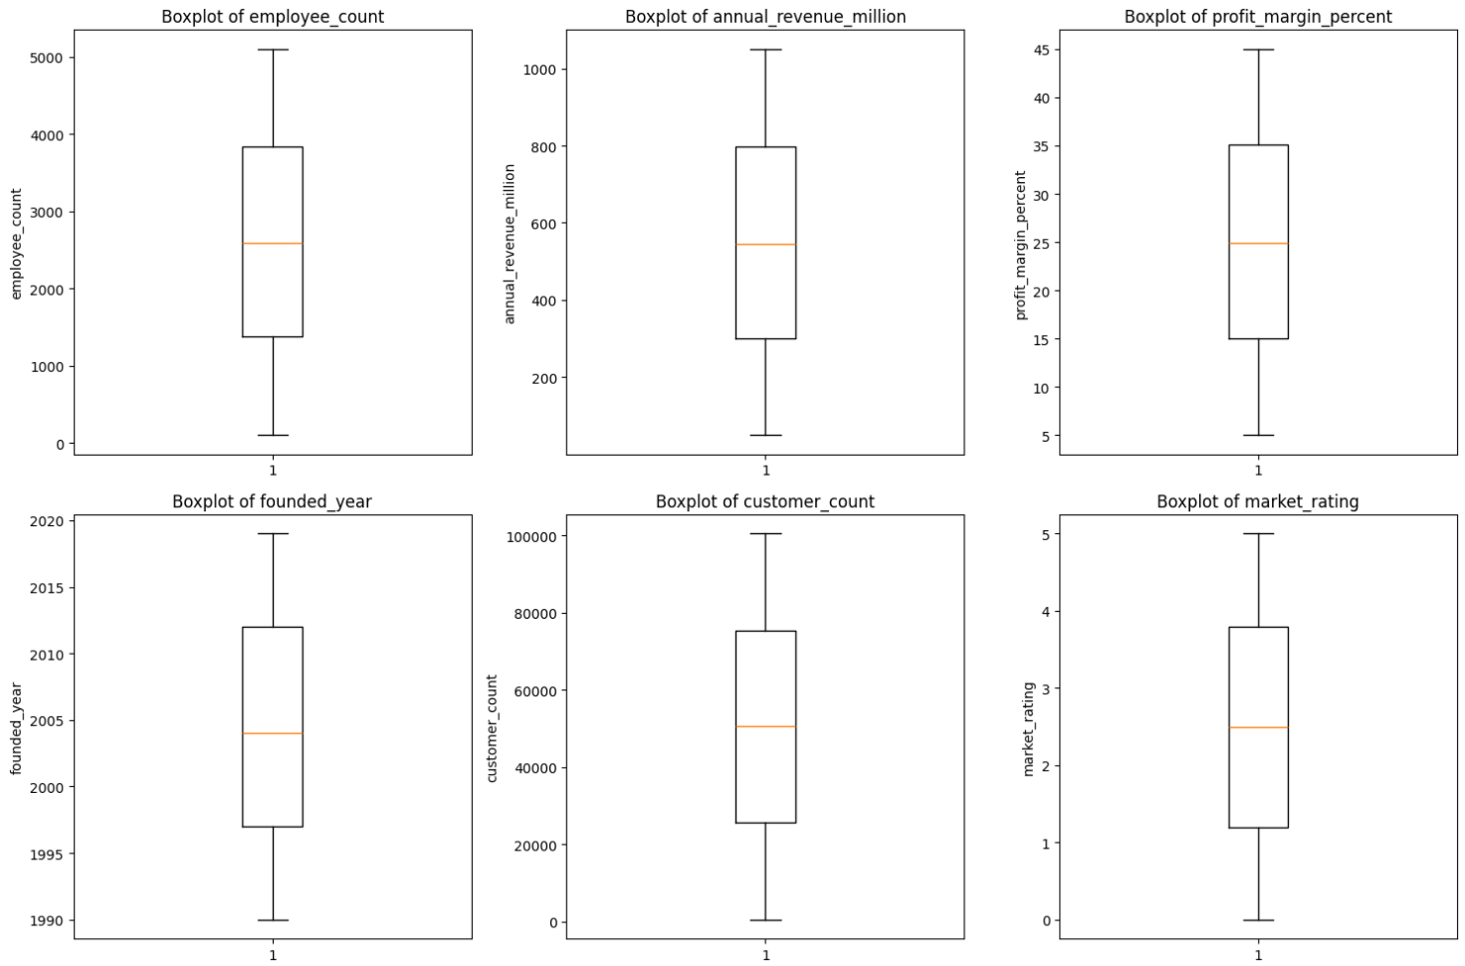
Boxplots: Variability and Outliers Across Numerical Metrics
Insights:
Outliers exist in size and revenue
Profitability is relatively tighter
Wide variability in customer base and age.

Slide 8
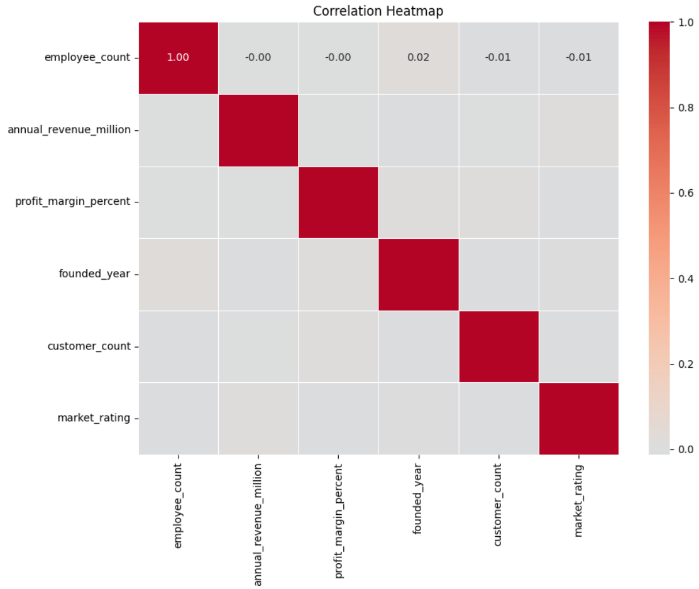
Correlation Heatmap: Linear Relationships Among Metrics
Insights:
Overall correlations are modest
Strong linear relationships are not apparent
Self-correlations are perfect by definition.

Slide 9
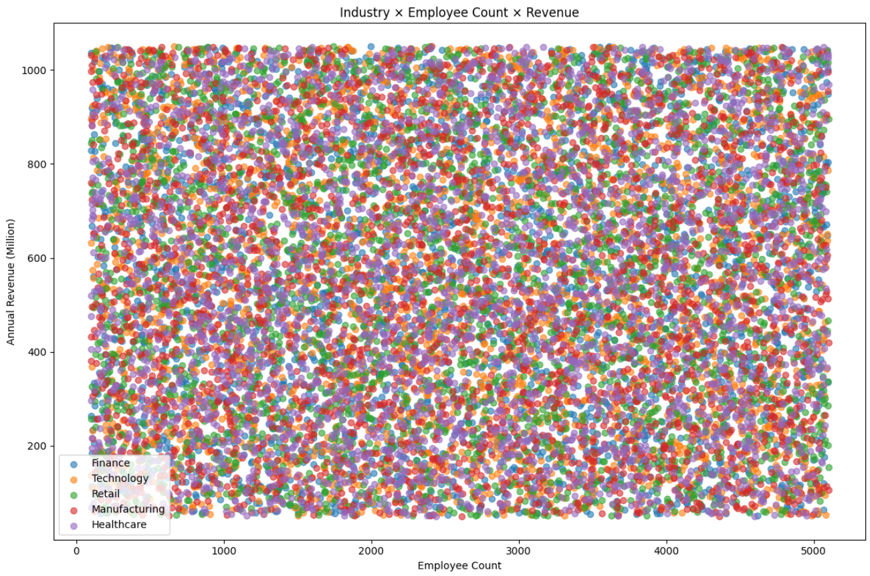
Industry × Employee Count × Revenue Scatter
Insights:
Positive size–revenue trend with notable industry-specific clustering
Some industries achieve higher revenue at similar headcounts.

Slide 10
Findings
• Revenue distribution is positively skewed
• Large enterprises contribute significantly to total revenue
• Technology sector dominates in revenue generation
• Retail sector handles the highest customer volumes
• Employee count strongly influences company revenue
• Outliers represent genuine large-scale companies and were retained

Slide 11
Challenges & Learning
Data fragmentation across size, revenue, and profitability makes it hard to define a single archetype.
Revenue concentration: a few high-revenue firms skew overall patterns, risking overlook of mid/low
performers.
Margin variability exists despite a central tendency, complicating uniform strategy.
Time-static snapshot misses trends like growth, churn, and lifecycle shifts.
Size versus performance mismatch: large firms don’t always outperform on profitability.
Choosing meaningful employee-count bands without losing nuance is tricky.
Distinguishing true outliers from data noise is essential for reliable insights.
Geographic and industry drift can mask multivariate drivers if analysed in isolation.
Linear correlations miss important nonlinear interactions (size × industry × region × revenue).
Data quality and tagging inconsistencies can bias results.

Slide 12
Conclusion
Overall: Diversified firm portfolio with balanced sizes, mid-range revenues, and solid profits.
Size (employee_count): Mostly mid-size; growth strategies should be size-band-specific.
Revenue (annual_revenue_million): Central cluster with a few high-revenue leaders driving
most total revenue.
Profitability (profit_margin_percent): Relatively tight margins, focus on efficiency and pricing
to lift them.
Key actions: Segment by size, run Pareto on top revenue firms, borrow best practices for
replication.
Cross-check: Explore nonlinear effects (industry/region interactions) for hidden drivers.
Limitation: This is descriptive, no causal conclusions or time trends.

Slide 13
Future Scope
Time-series expansion: add revenue/headcount trends and churn to capture growth lifecycles and
seasonality.
Deeper segmentation: develop size-, industry-, and region-specific playbooks plus contract-
value/customer-type dimensions.
Advanced analytics: apply nonlinear ML models and interaction terms to uncover hidden drivers
beyond linear correlations.
Predictive dashboards: build scenario-based, lightweight decision-support tools for executives and
frontline teams.
Governance & benchmarking: establish data quality, tagging standards, risk analytics, and a top-
quartile benchmarking program to guide actions.

Slide 14
THANK YOU

